Slide 1

Team Members
Yinon Levi
Shahaf Israel
Supervisor
Dr. Moshe Sulamy

Slide 2
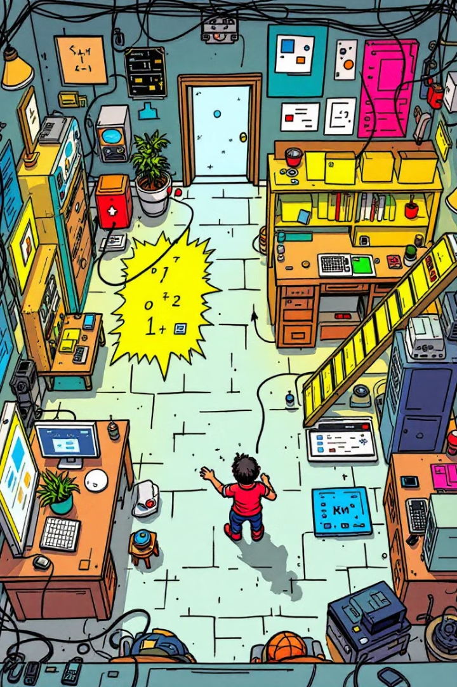
EscapeCode: A Programming Puzzle Game
Innovative Learning Through Interactive Challenges
An accessible gaming experience for individuals with disabilities.

Slide 3
Introduction
The Current Situation
Our Solution
People with disabilities have various hobby opportunities,
but limited access to computer-based activities
A gamified, accessible platform combining programming puzzles with escape room mechanics
The Problem
Project Goals
Lack of enjoyable and educational applications that are
accessible to individuals with disabilities.
Enabling people with disabilities to learncoding in an enjoyable, accessible way

Slide 4
Current Situation == Problem
1
Limited Hobby Options
3
Gaming challenges
People with disabilities have fewer accessible hobbies to choose from
Lack of adaptive controls and need for special expensive equipment
2
Coding Challenges
4
Lack of Integrated Solutions
Learning coding as a hobby is difficult due to accessibility barriers
Few platforms combine accessible coding and gaming experiences

Slide 5

Analysis of the Problem
1
Complicated use
2
High Costs for Gaming
3
Lack of accessible learning
Using a computer can be difficult for people with disabilities
Adaptive gaming tools are often expensive and out of reach
No interactive coding tools for individuals with disabilities

Slide 6



Proposed Solution: EscapeCode
Unique gaming experience for individuals with disabilities.
Escape Room Mechanics
1
Programming Puzzles
2
Each puzzle teaches a new coding concept
Interactive Gameplay
3
Adaptive hints, real-time feedback, and interactive tutorials

Slide 7
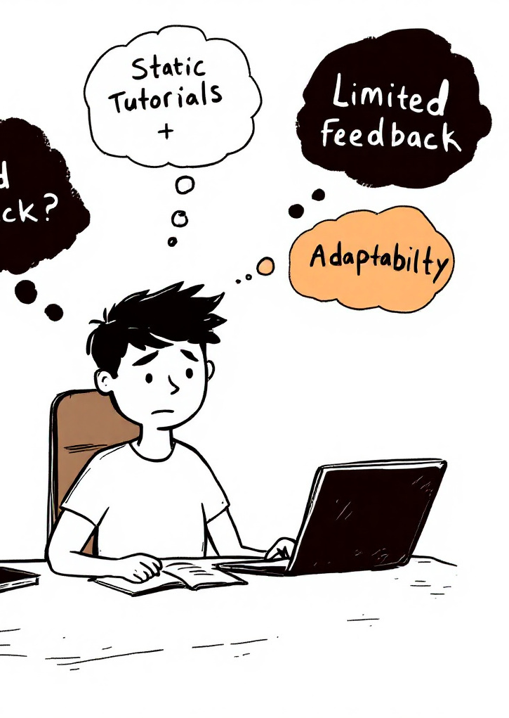
Engineering and Development Challenges
Tool Exploring
Accessible Gaming
Identifying and integrating
suitable tools into the game
Enhancing gameplay with minimal special equipment
Understanding The Target Audience
recognizing the limitations of people with physical disabilities in using computers

Slide 8



Technologies
Eye-Tracking
AI Bot
Detecting eye movements,
replacing use of mice
Provides interactive assistance, bridge
Between user written code and its execution
Speech-to-Text
Converts spoken language into written text,
replacing use of keyboard

Slide 9
Research Approach
1
Exploring Existing Technologies
3
Proof of Concept
Reviewing existing accessibility solutions like Rasa, GazePointer and Google STT
Performing a POC to validate that the algorithms, function as expected
2
Cost-Benefit Analysis
4
User Involvement in the Process
Evaluating technologies based on their cost versus capabilities
Early involvement of disabled users to ensure accessibility

Slide 10
Development Frameworks & Tools
Unity
Whisper
A game engine used for designing the interface and puzzles in the escape rooms
Implementing offline Speech-to-Text functionality
OpenCV
Rasa
An offline library for eye-tracking using standard webcams
A platform for developing an offline, interactive, customized AI bot

Slide 11
Constraints
Basic hardware
Time and resources
Support for regular cameras and microphones only
Use of free and open-source tools due to budget constraints
Accuracy and performance
A requirement for 90% accuracy in eye tracking and speech recognition under varied conditions

Slide 12
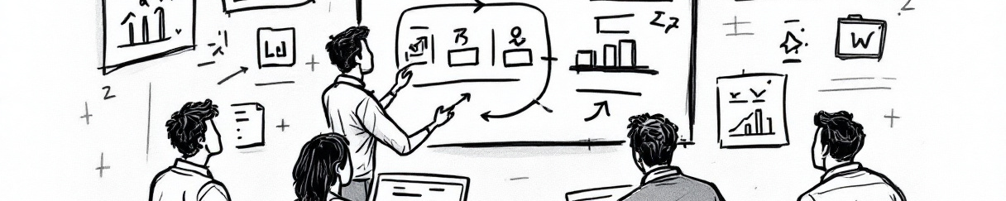
Engineering Development Process
Requirements
Development
Identify user needs
Implement core features
1
2
3
4
Design
Testing
Develop UI prototypes
Perform different tests

Slide 13
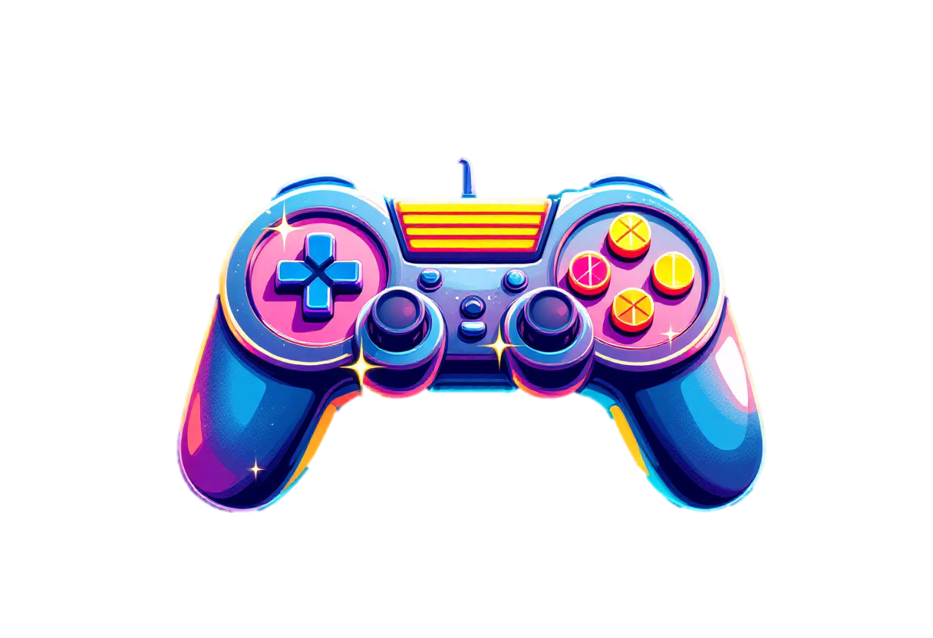



Action Logic Overview
Input
The player receives stimuli via eye-tracking or voice
Processing
The system interprets the input and performs
Output
The system responds accordingly
Progression
4
Correct answers advance, incorrect ones require a retry
Completion
5
Solve all puzzles to finish the game

Slide 14
Main System Process
Sequential Process Execution
Puzzle solving and room unlocking executed in sequence
Real-Time Input Processing
Processes gaze and voice commands as they occur
Event-Driven Triggers
Actions like puzzle solving or hint requests triggered by events

Slide 15
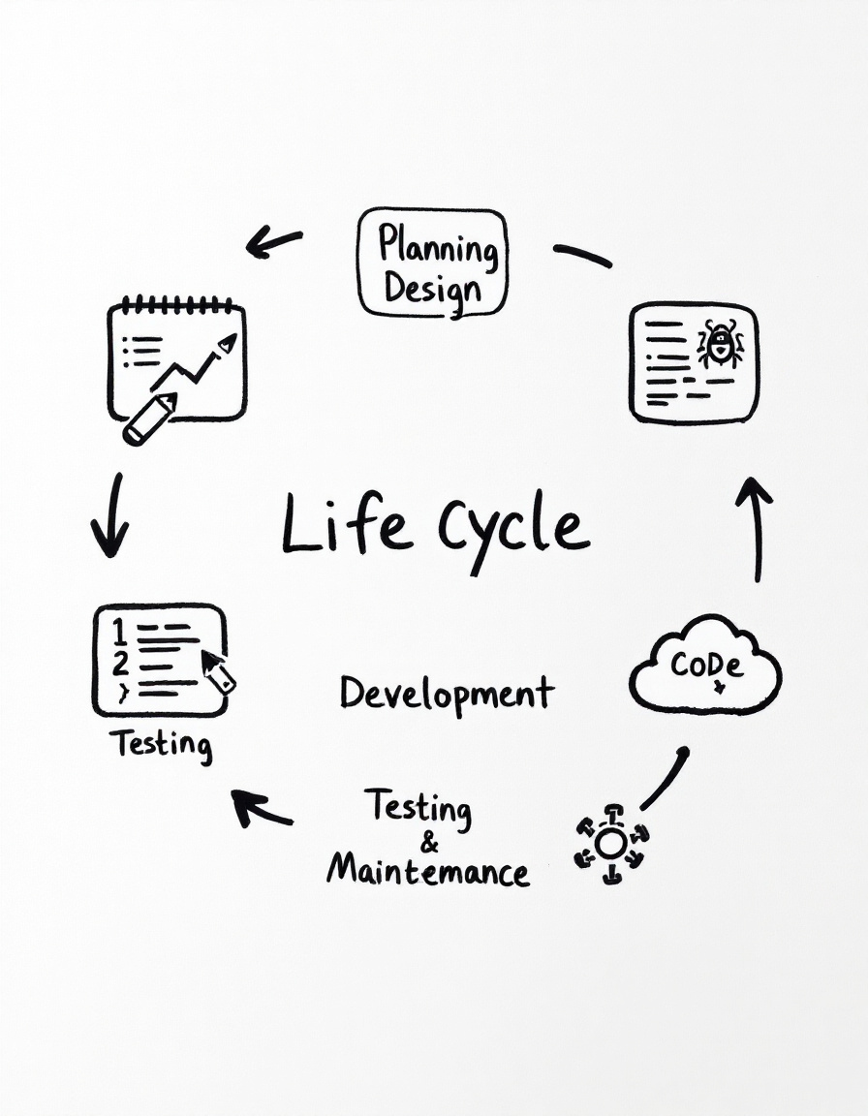
Software Architecture
Object-Oriented Design
Modular structure with classes for Game, Player, Puzzle, etc
Modular Components
Separate components for each game functionality
Centralized Game Controller
Manages overall game state and player progress
Cross-Platform Compatibility
Ensures functionality across various systems and configurations

Slide 16
Data Structure
JSON for Progress and States
Stores game progress and puzzle states in a structured format
SQLite for Player Data
Efficient real-time data management for player stats and progress
Lightweight Structures
Optimized for memory usage to support smooth performance
Real-Time Updates
Ensures consistent synchronization across the game systems

Slide 17
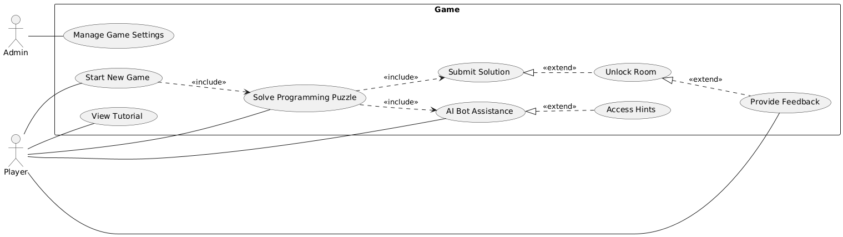
Use Case Diagram

Slide 18
User Interface
Intuitive UI Design
Simple and interactive interface design
Tutorial Mode
Step-by-step guidance for eye-tracking and AI Bot Interface
AI Bot Hints
provides hints and guidance in real-time based on the player’s game progress
Accessibility Options
Customizable options for font size, contrast, and input sensitivity
Visual and Auditory Feedback
Immediate visual and auditory feedback on actions

Slide 19
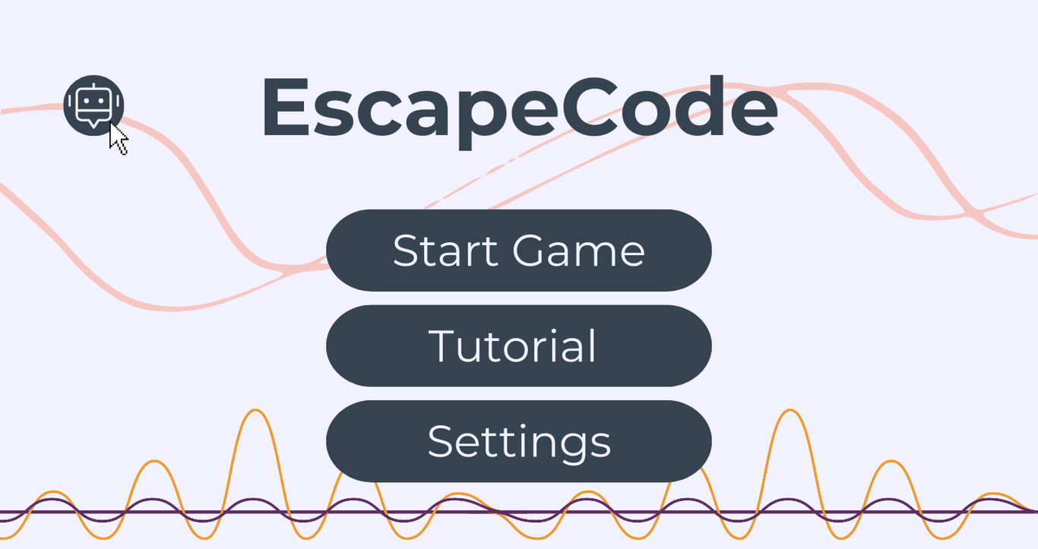

Slide 20
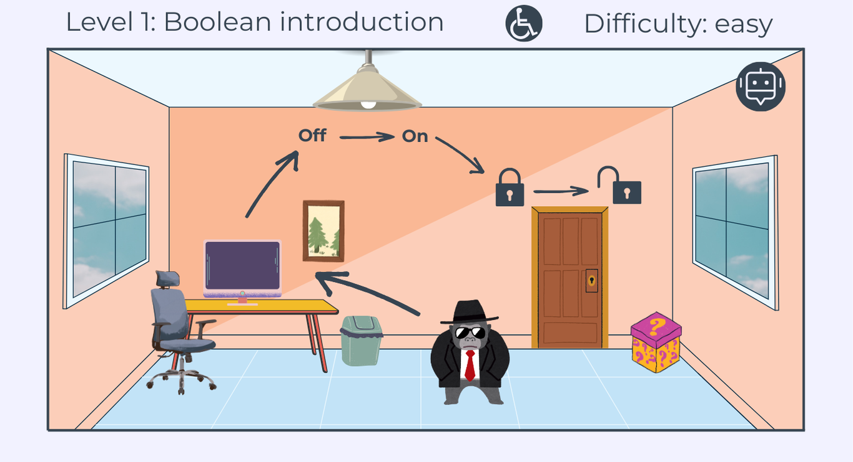

Slide 21
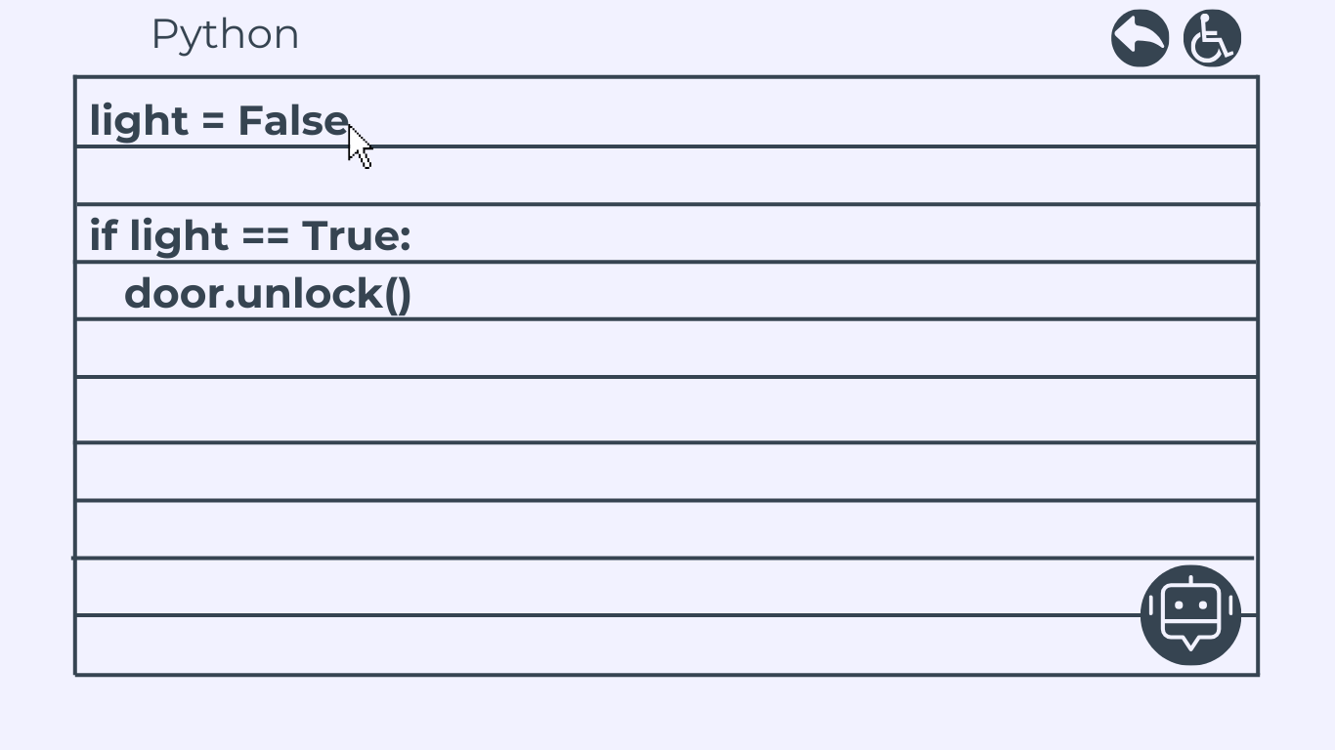

Slide 22

Test Plan Overview
Unit Testing
Integration Testing
Test individual components
Test interaction between core systems
Execution
Execution
Automate tests to verify accuracy under different conditions
Simulating puzzle-solving with eye tracking and voice commands
Expected Results
Expected Results
Validated functionality with minimal errors
Seamless transitions and compatibility between systems
Challenges
Challenges
Variability in input accuracy, environmental factors
Complex integration, timing issues between systems

Slide 23
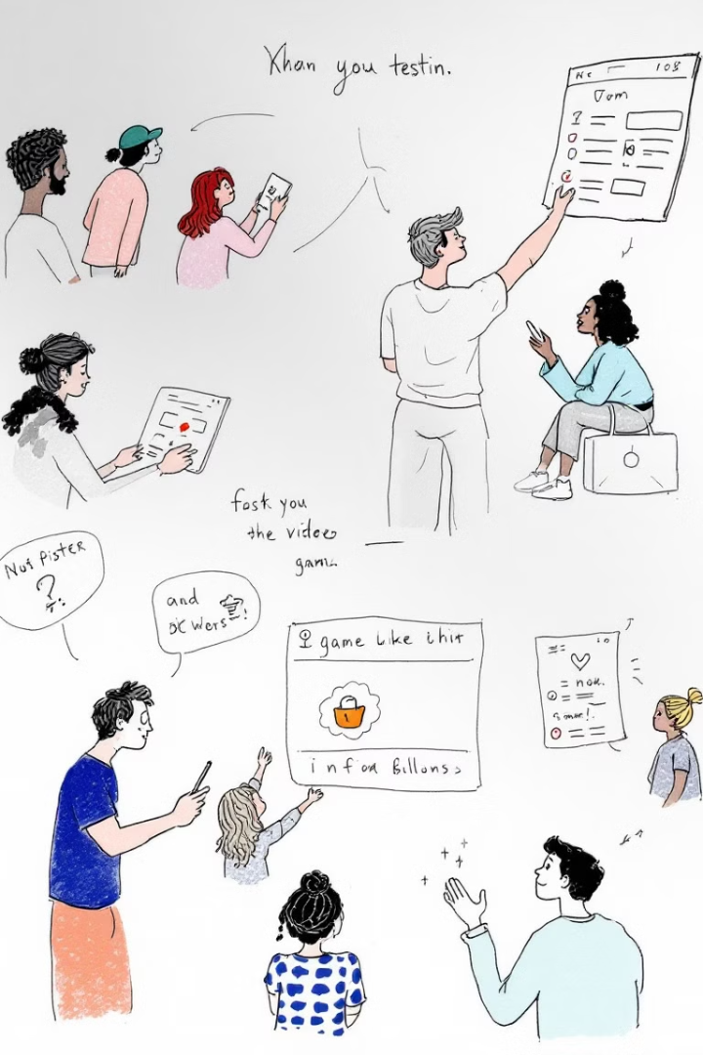
Test Plan Overview
Usability Testing
Performance Testing
Assess the game’s accessibility
Measure system resource usage
Execution
Execution
Involve target users, including those with disabilities
Stress-test on mid-range PCs with standard peripherals
Expected Results
Expected Results
Positive feedback on usability and navigation
Game runs smoothly with optimized performance
Challenges
Challenges
Diverse user needs, ensuring inclusivity across all disabilities
Balancing resource consumption and game quality under stress

Slide 24
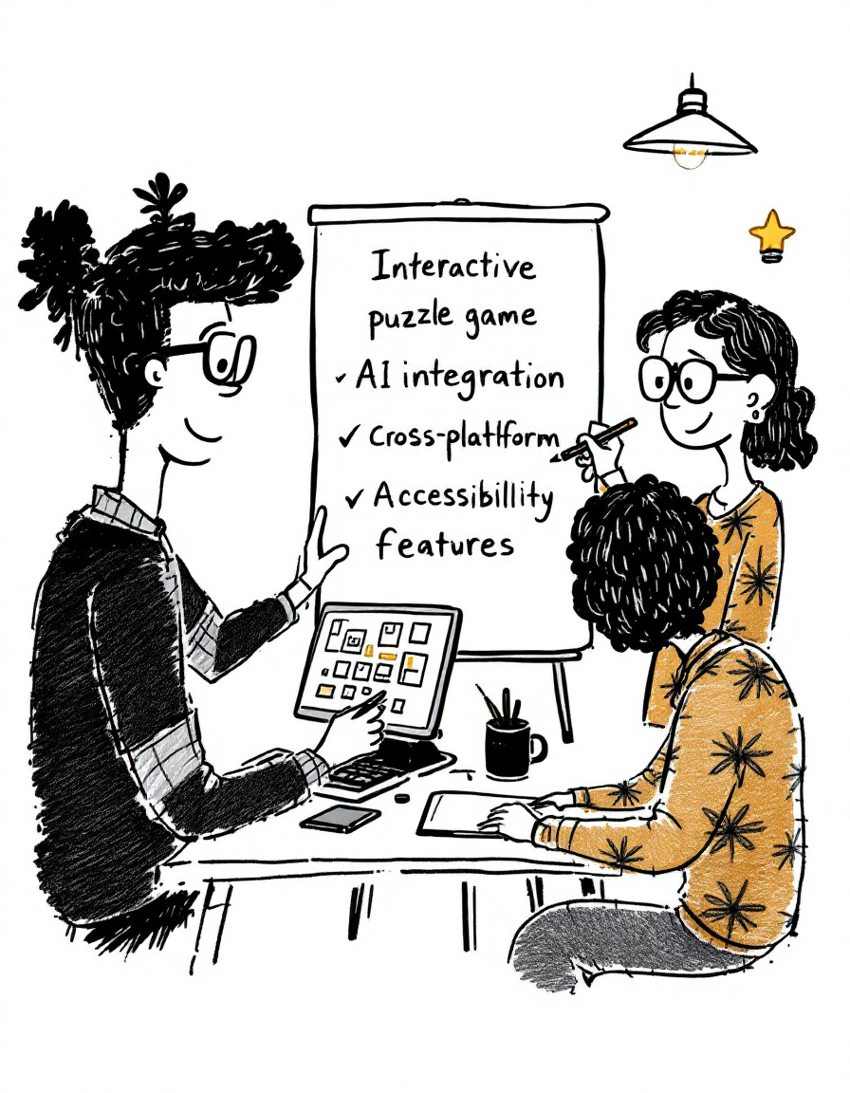




Project Deliverables
Interactive Puzzle Game
AI Integration
Interactive coding puzzles and room unlocking for education
Dynamic hints and feedback based on user input
Cross-Platform
Accessibility Features
Compatible across various
devices and operating systems
Adjustable settings for font size,
contrast, and input sensitivity

Slide 25

Innovation and Contribution
Unique Learning Approach
Merges coding challenges with escape room mechanics
for engaging and hands-on learning
Eye-Tracking and Speech Integration
Features gaze-based input and voice commands for an
intuitive and immersive user experience
Accessibility Focus
Designed with customizable features for users with physical disabilities, ensuring inclusive gameplay for all

Slide 26
THANK YOU!
QUESTIONS?

